Slide 1
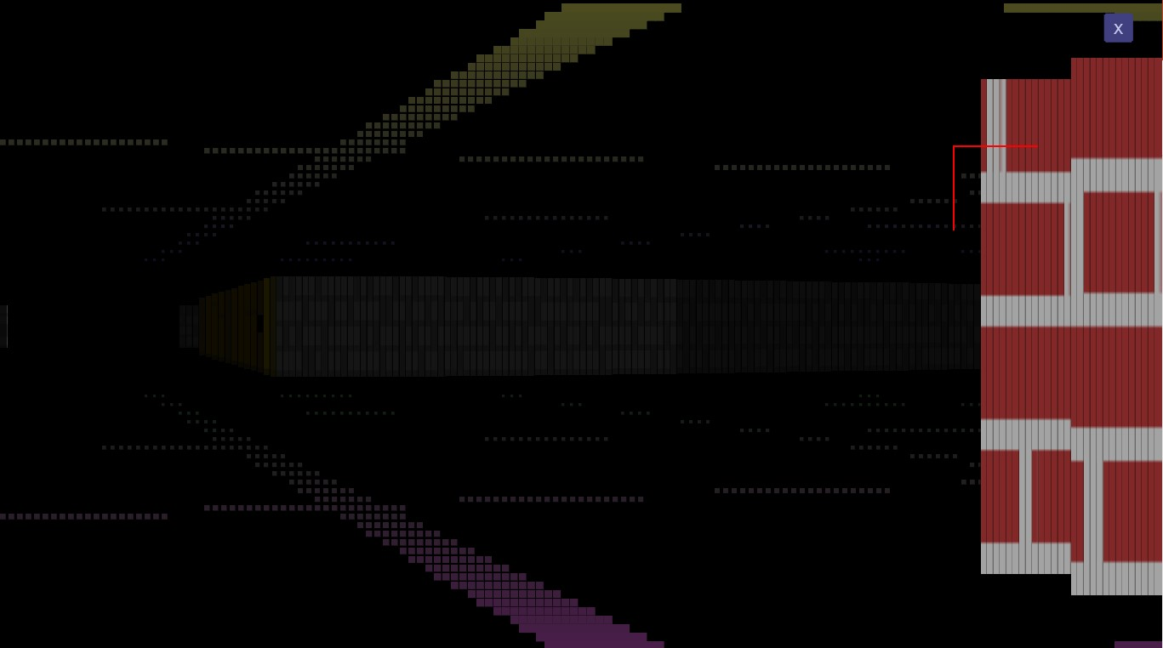
Mystic Chambers
JavaScript Pitch
Lead: Bilal A. Cheema
8th March to 28th June (16 Weeks or 4 Months)

Slide 2

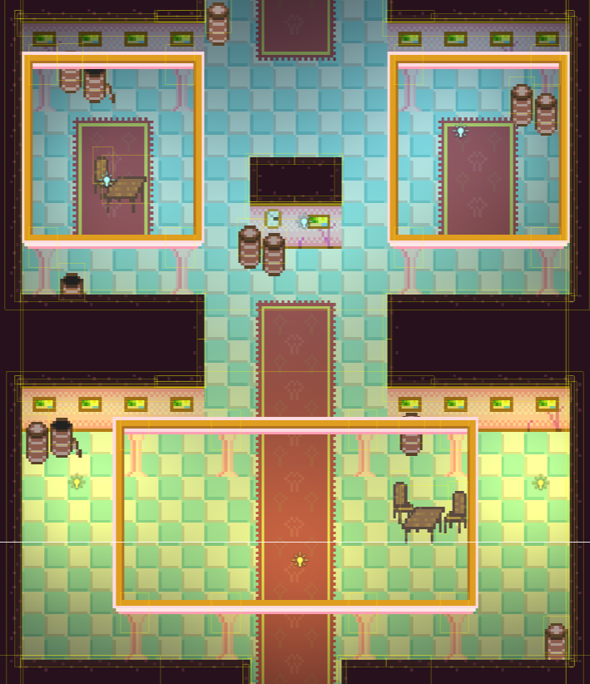
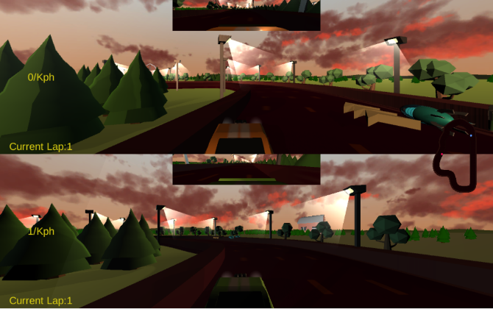
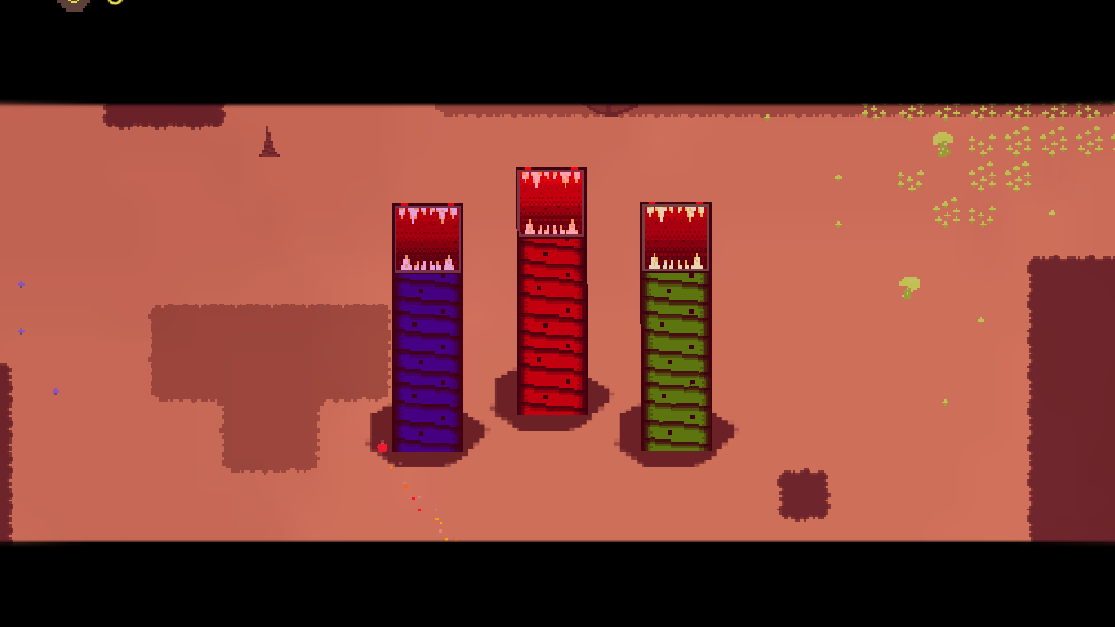

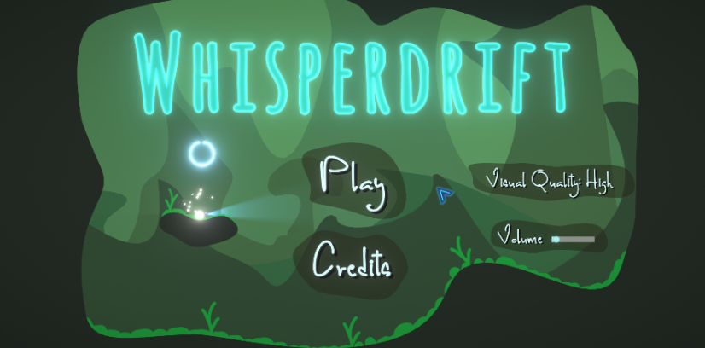
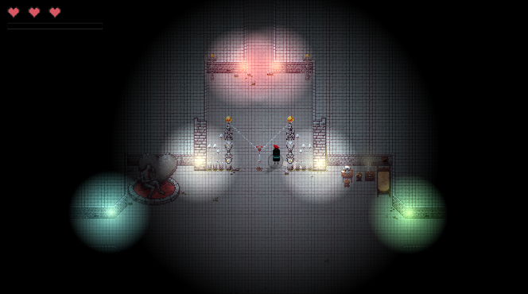
My Experience
Made Small Games with C++, SDL2, JavaFX and Unity.
Contributed to 7 Club Games: WhisperDrift, Wild Drivers, Delv, Alien Overrun, Exit the Shadow, Ghost Rustlers, Nethercard Kingdom.
Led a Unity 2D Game called Nick Of Time

Slide 3
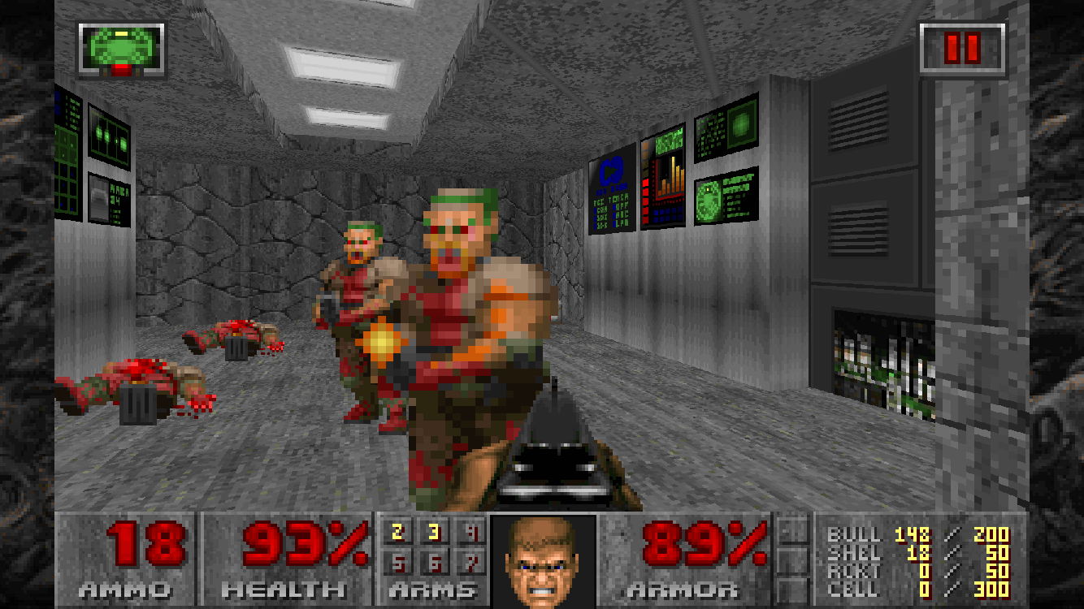
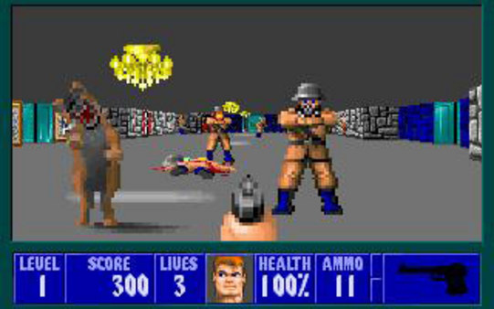
Inspirations
Definitely, Doom II
But will look more like Wolfenstein 3D because we will be using raycast 3D unlike Doom which uses BSP.

Slide 4
I want to get better in…
Talk-to-Camera Skills (I won’t be live in most of the weekly meetings; most of them will be recorded videos)
Problem Solving Skills
Cooperation and Team Work
Finishing-Game Skill
Level Design and Puzzle Elements

Slide 5
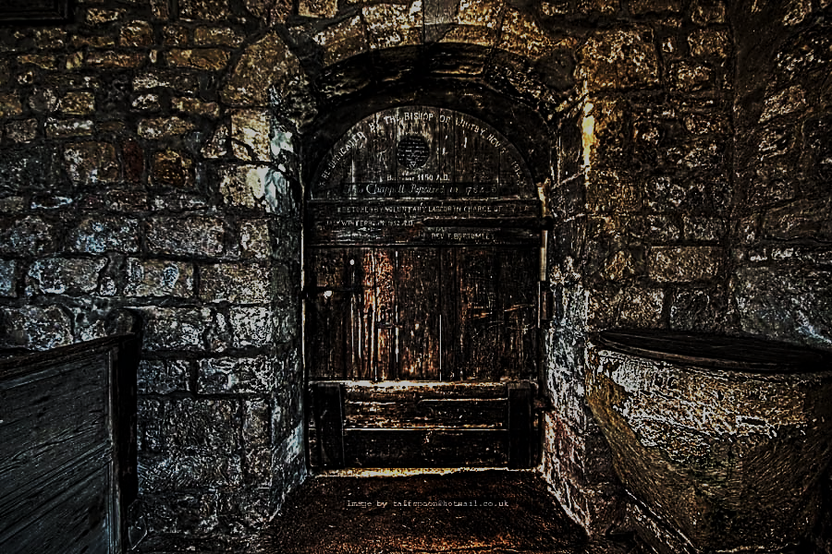
Let’s enter the Mystic Chambers!

Slide 6
Minimal Objectives
Raycast 3D Dungeon Crawler
16X16 Dark Pixel Art scaled to 160X160 (there are exceptions like Guns)
Basic Storyline: To find Mystus Treasure. But there are enemies, traps and puzzles. Old Rusty Guns. Complete 6 Levels and get to it.
6+ Items, 2+ Guns, 3+ Enemies, 14+ Décor, 8+ Walls.

Slide 7
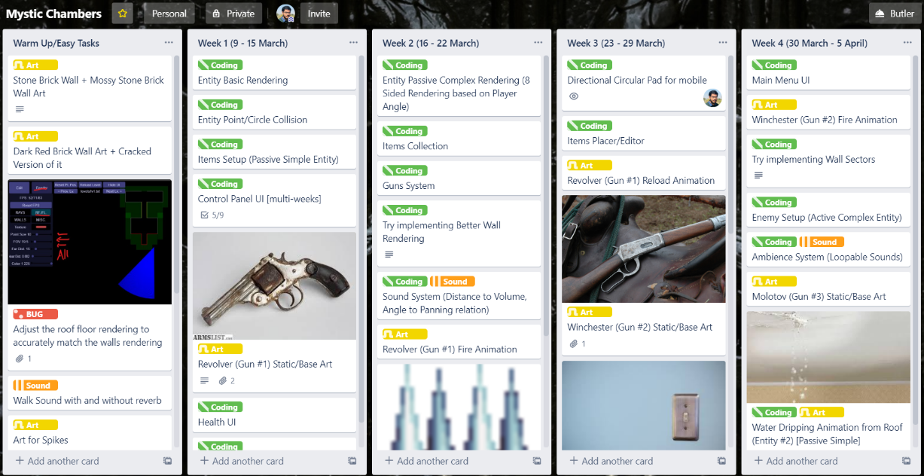
Schedule

Slide 8
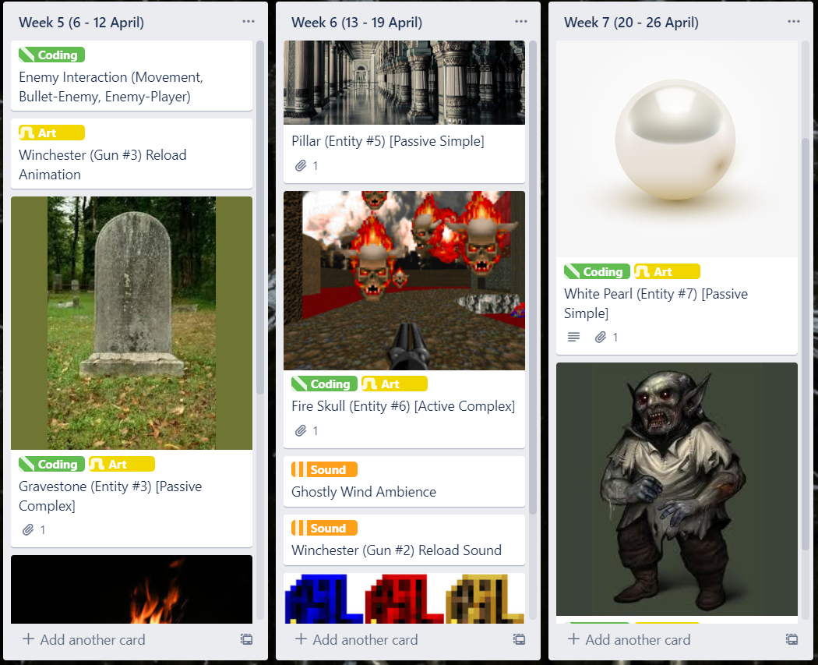
Schedule

Slide 9
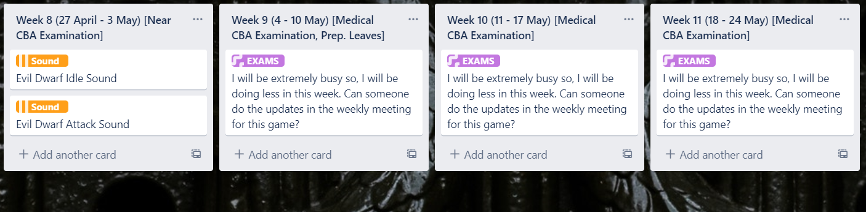
Schedule – Exams Period
Starting from 27 April to 24 May

Slide 10
Programming (JavaScript)
Entity Rendering (Simple – 1 image, all sides; Complex – 8 images, 1 image for each side based on player angle)
Entity Point Collision
Items System
Inventory System
Guns System
Gameplay UI (HP Bar, Bullets Count)
Sound System
Items Placer/Editor
Main Menu UI
Wall Sectors
Enemy Setup
Enemies: Fire Skull, Evil Dwarf, Druid
Ambience System
Enemy Interaction (Movement, Bullet-Enemy, Enemy-Player)
Key-Door System (like Doom 2)
Improved Wall Rendering
Wall Switch

Slide 11
Art (Dark Pixel Art; mostly 16X16)
Stone Brick Wall + Mossy version of it
Dark Red Brick Wall + Cracked version of it
Guns Static, Shoot and Reload: Revolver, Winchester, Molotov
Fire Animation
Spikes
Key/Door
Health Box
White Pearl
Injection
Pillar
Water Dripping Animation
Enemies Idle, Walk, Attack: Fire Skull, Evil Dwarf, Druid

Slide 12
Audio (Dark Ambience; Creepy Sounds)
Walk sound (with and without reverb)
Guns Reload and Shoot sounds: Revolver, Winchester, Molotov
Fire
Water Dripping
Enemies Idle, Move, Attack sounds: Fire Skull, Evil Dwarf, Druid
Ghostly Wind Ambience

Slide 13
Who’s in? Questions?
Thank you for listening!

